Slide 1
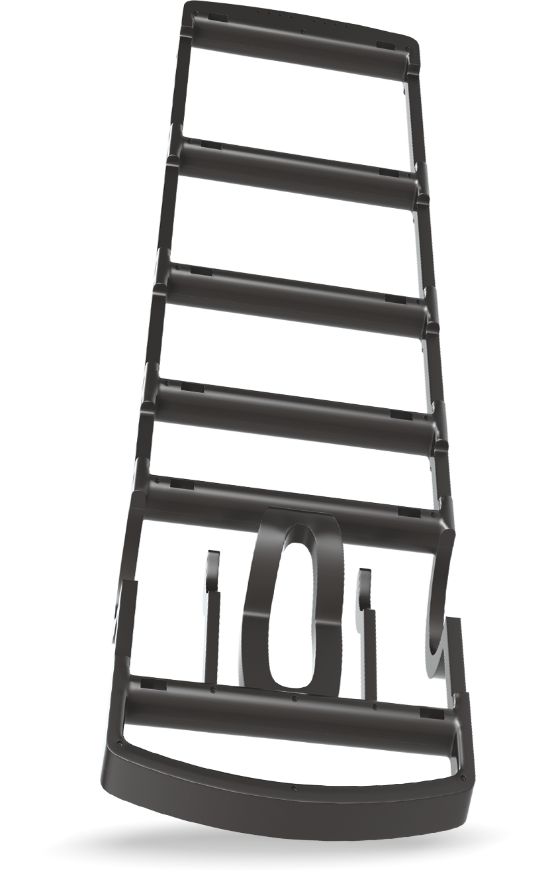
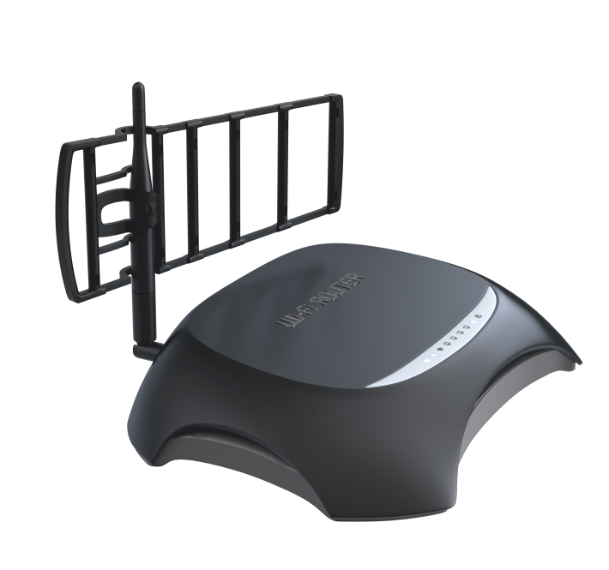
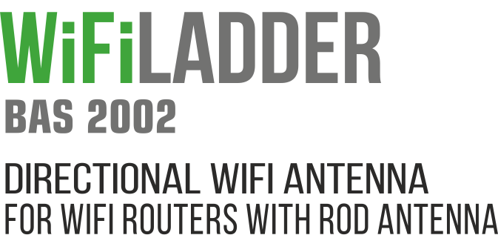

Slide 2
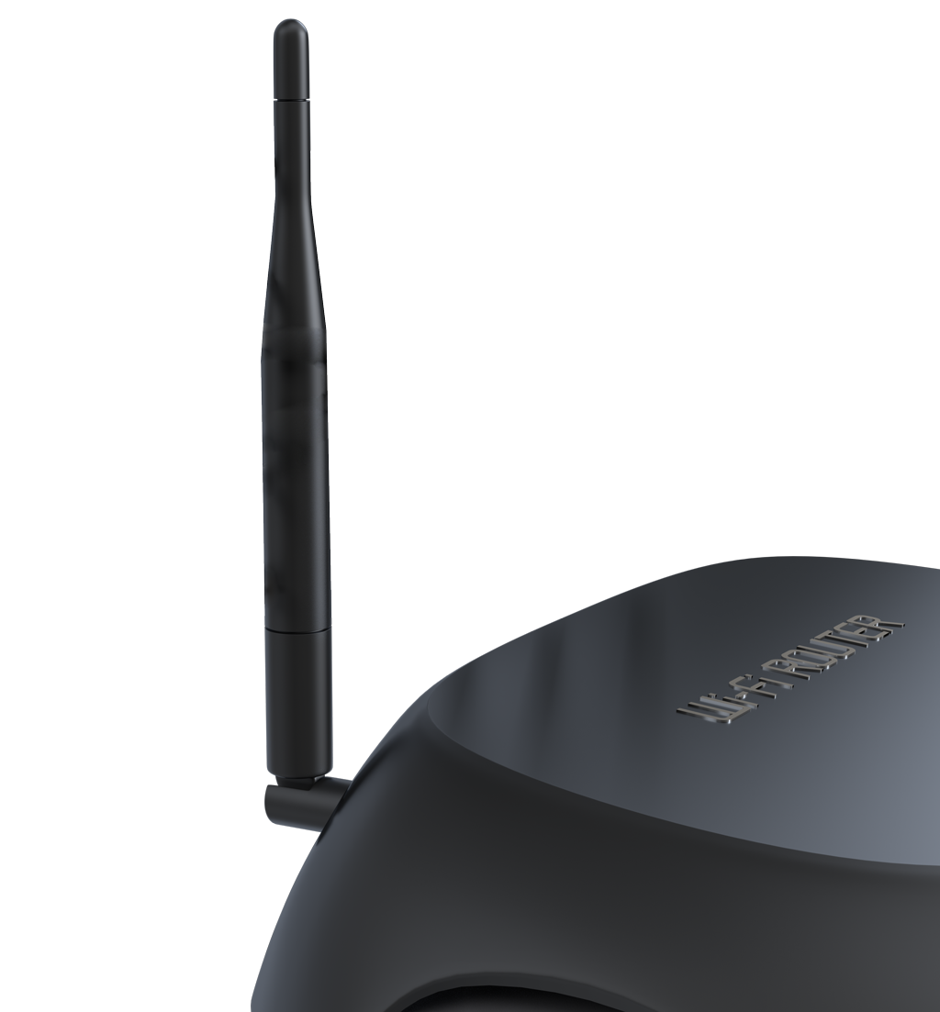
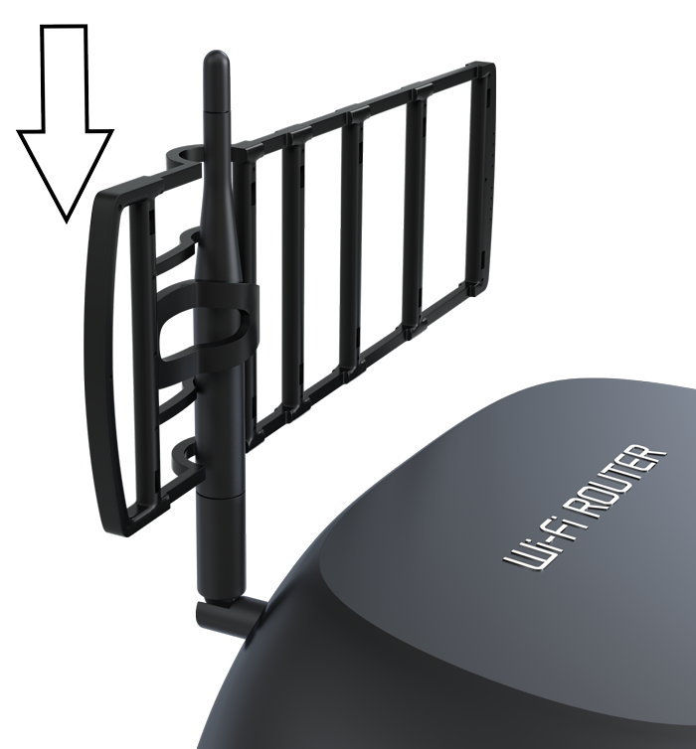
WIFI LADDER ANTENNA PROVIDES TO EXPAND COVERAGE OF YOUR HOME OR OFFICE WIFI NETWORK INTO DESIRED DIRECTION
INCREASES WIFI ROUTERS OPERATING RANGE IN THE SELECTED DIRECTION UP TO 3 TIMES.
WIFI DIRECT IS MANUFACTURED AS EXTENSION, IT IS EASY MOUNTED ON STATIONARY ROUTER OR ACCESS POINT ANTENNA, AND CAN BE POINTED TOWARDS SPECIFIED DIRECTION.

Slide 3
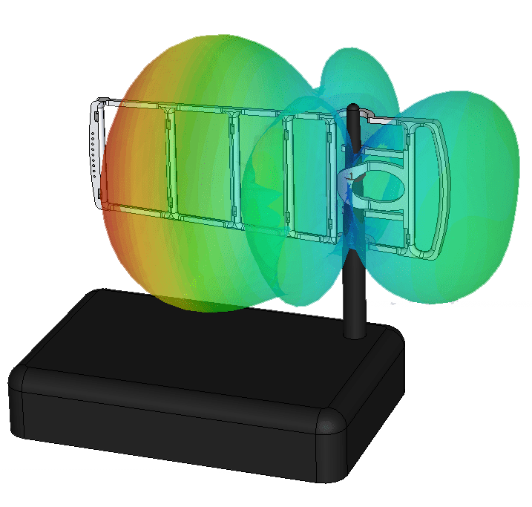
WIFI LADDER IS 7-ELEMENT YAGI ANTENNA. IT HAS DIRECTIONAL FEATURES AND AMPLIFIES TRANSMITTED WIFI SIGNAL TOWARDS SPECIFIED DIRECTION.
DIMENSIONS OF DIRECTORS AND DISTANCES BETWEEN THEM ARE OPTIMIZED IN PHYSICAL MODEL; THAT ENABLED TO REACH BETTER RATES OF WIFI SIGNAL GAIN.

Slide 4
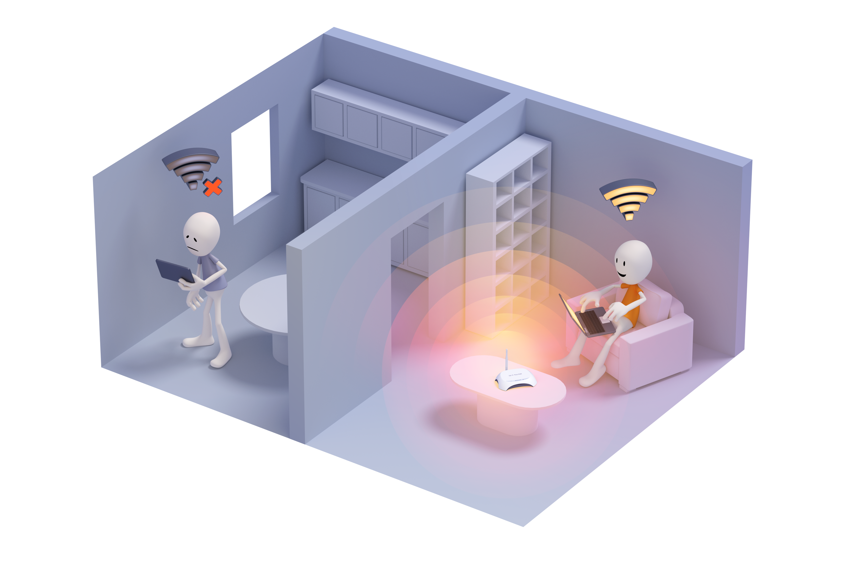
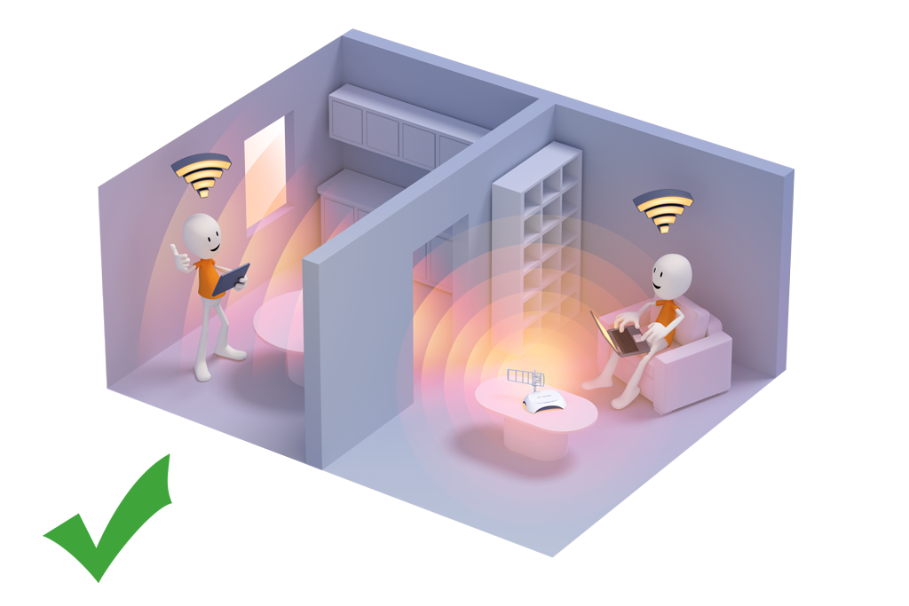
FEEL THE DIFFERENCE IMMEDIATELY
IN the APPARTMENT

Slide 5
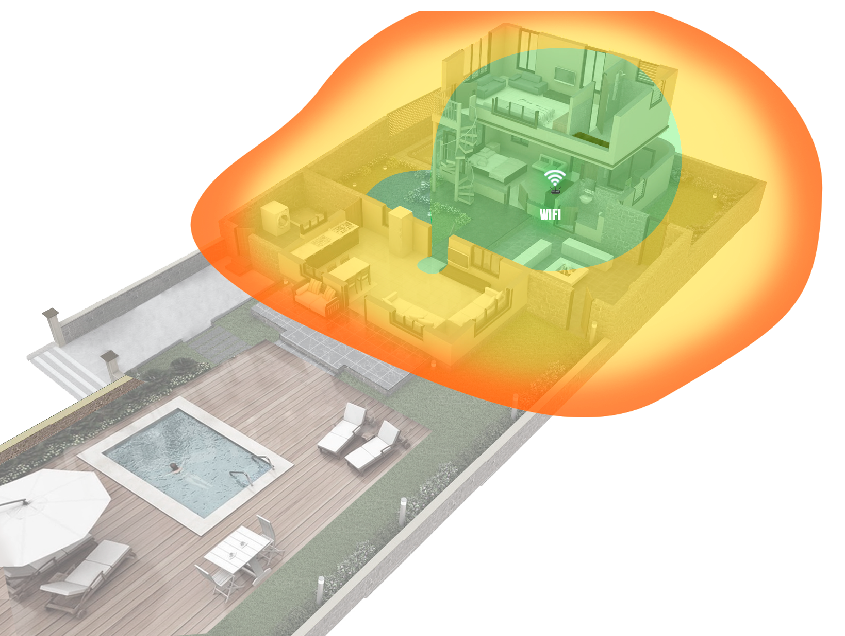
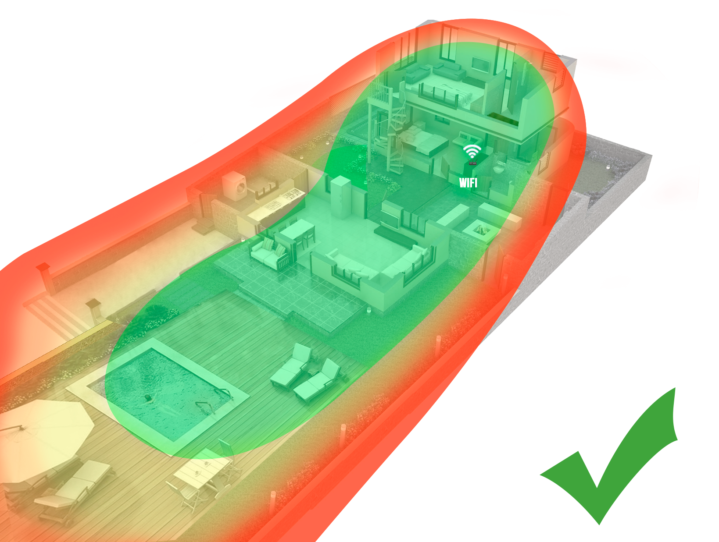
POINT YOUR WIFI WHERE YOU NEED IT
IN THE COUNTRY HOUSE

Slide 6
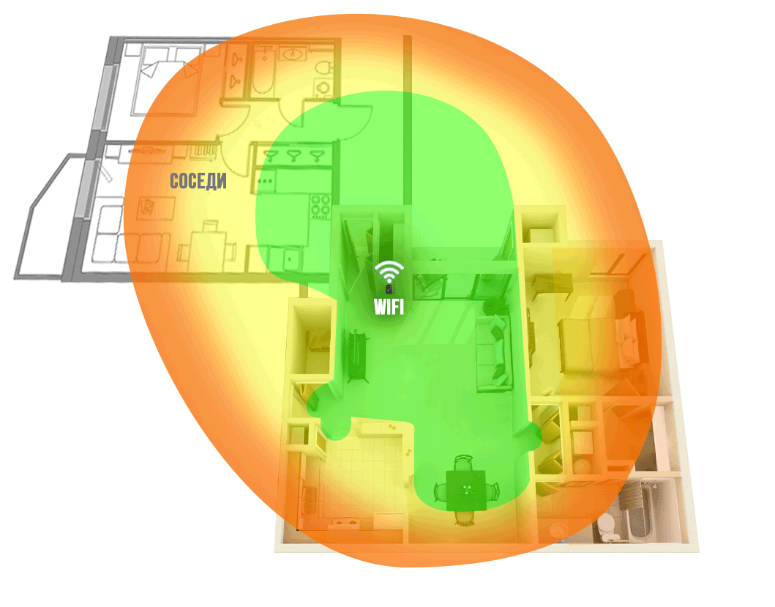
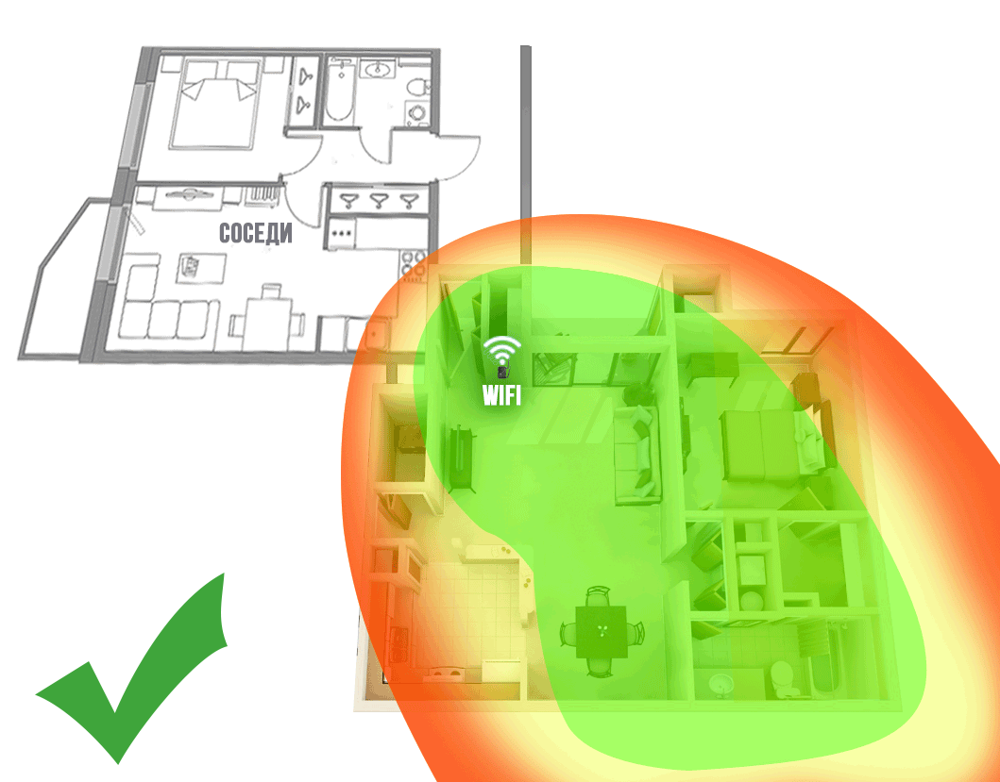
YOU NEED WIFI MORE THAN YOUR NEIGHBOURS
IN THE APPARTMENT

Slide 7
WHY IT’S YOU WHO NEEDS IT
IT HELPS YOU TO COVER ‘BLIND’ WIFI AREAS
IT INCREASES WIFI ROUTERS OPERATING RANGE IN THE SELECTED DIRECTION UP TO 3 TIMES
WIFI LADDER ANTENNA EXTENSION DOES NOT HAVE WIRES AND IT IS NOT CONNECTED TO THE WALL SOCKET
IT IS SIMPLE AND RELIABLE DESIGN
IT IS EASY TO MOUNT ONTO ROUTER ANTENNA. EASY TO TUNE
IT IS SAFE AND LONG-LIFE

Slide 8
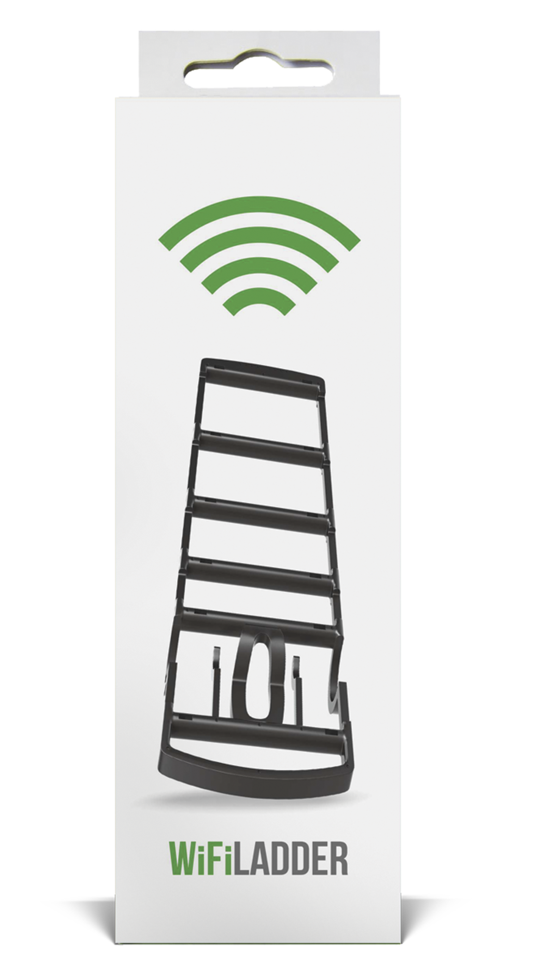
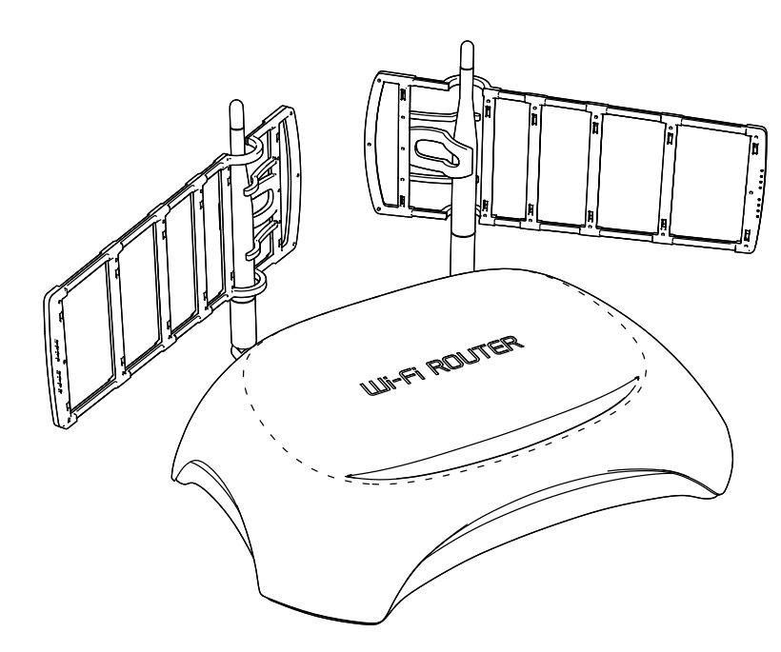
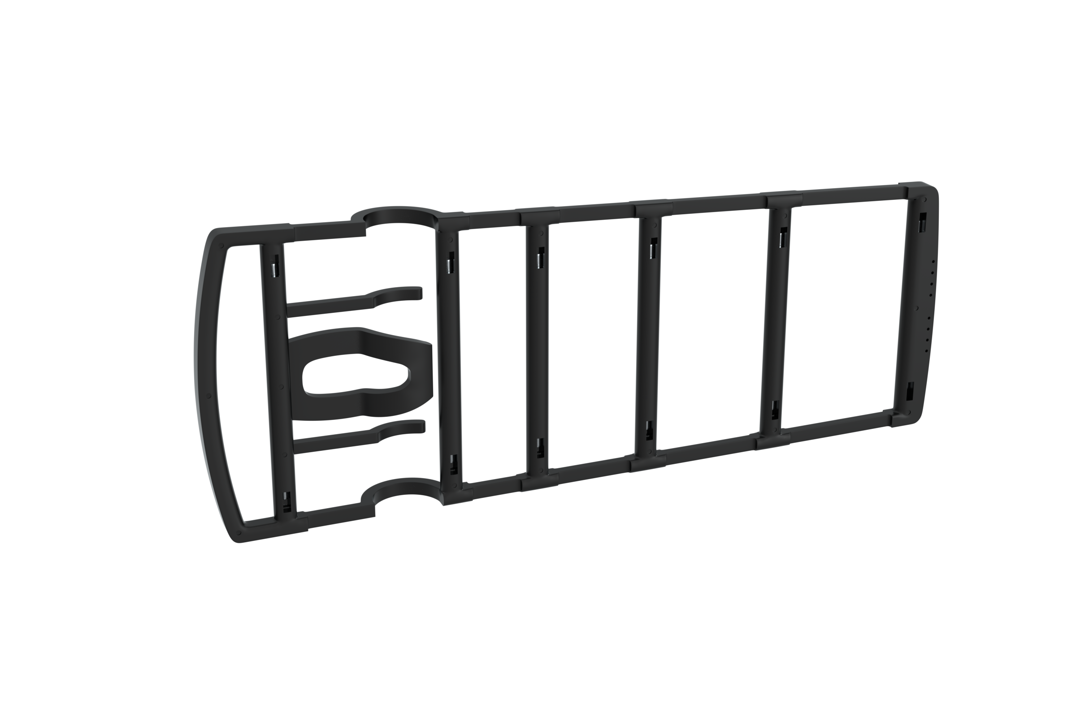
EXCELLENT MARGINALITY AND ELEGANT APPEARANCE
THE ANTENNA IS EXCELLENT ACCESSORY IN THE NETWORK CATEGORY.
100% MADE IN RUSSIA.
UNIQUE PROPRIETORY SOLUTION.

Slide 9
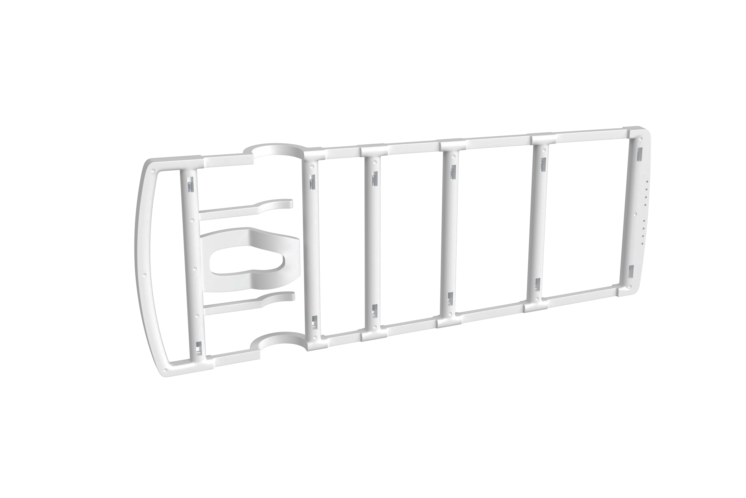
Oem ready
ORDER ANTENNA OF YOU CUSTOM DESIGN.
PRODUCTION PROCESS ALLOWS US TO MODIFY ANTENNA BRANDS FOR MAJOR CUSTOMERS AND OEM CLIENTS.
CUSTOMIZED ARE:
FULL COLOR LINER ON YOUR PACKING
ANTENNA COLOR
PASSPORT
WARRANTY CERTIFICATE

Slide 10
REMO LTD.
50 LET OKTYABRYA 101, SARATOV, 410033, RUSSIA +7(8452) 49-32-35 online@remo-zavod.ru

