Slide 1
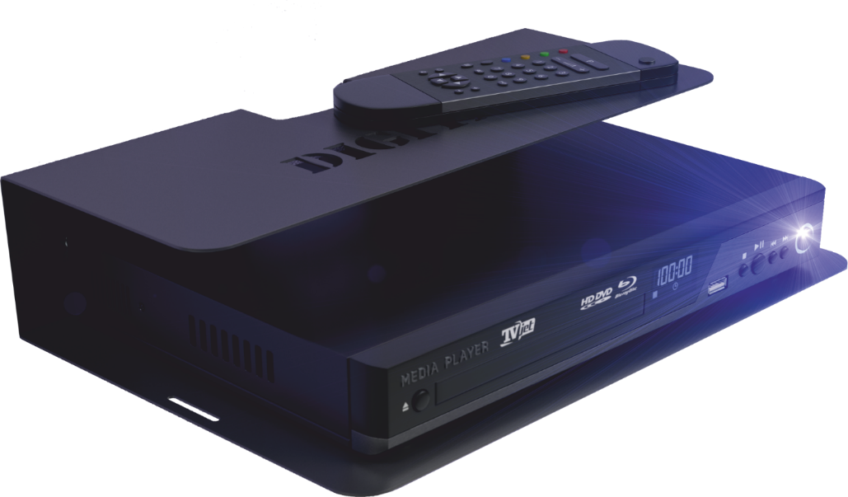

Slide 2
- Thinking of where to put your digital TV tuner after home repair? - You purchased a console, but have no idea where to put it? - All shelves you found in the shop do not match your interior? - Looking for a shelf with exceptional and unique design?

Slide 3
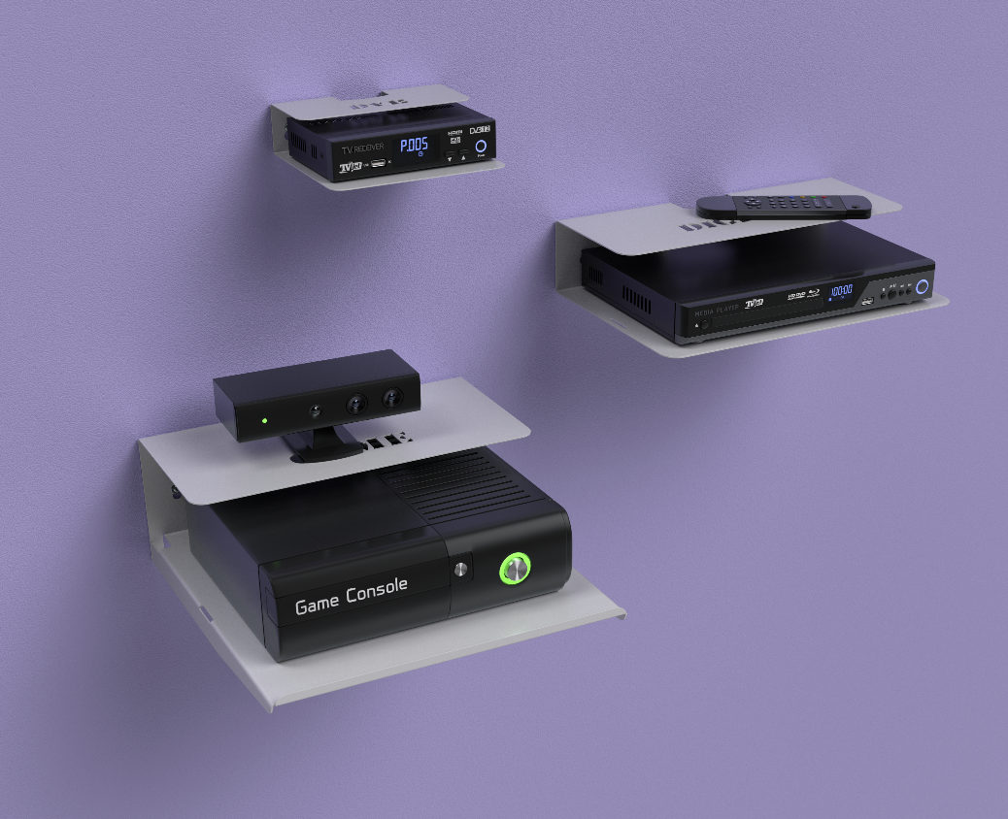
Here is your simple and nice solution
Excellent design
Simple mounting
Comfortable environment to use your accessories
Perfectly fits any interior
Unique manufacturing performance

Slide 4
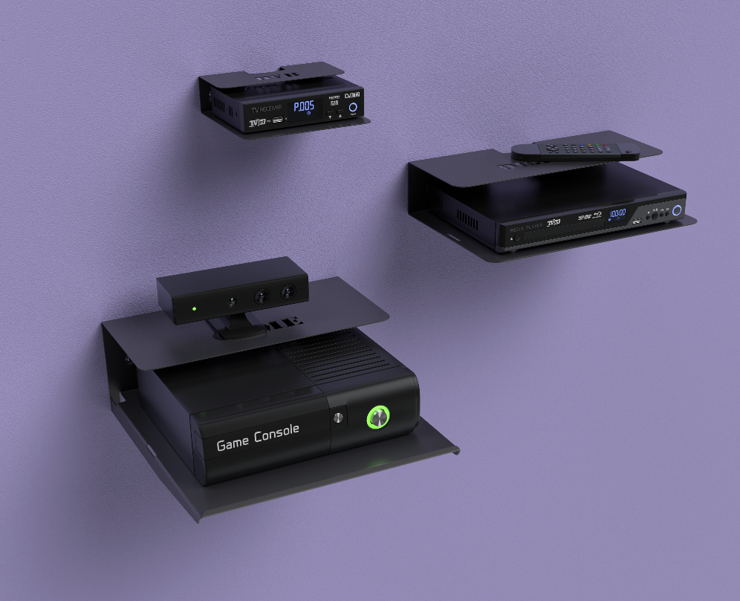
WEB-CAMERAS
PHONES
USB STORAGE MEDIA
HEADPHONES
REMOTE CONTROLS
INDOOR TV ANTENNAS
SATELLITE RECEIVERS
DVD AND MULTIMEDIA PLAYERS
PLAYSTATIONS AND CONSOLES
WI-FI ROUTERS
Digital TV tuners
Fit any accessories

Slide 5
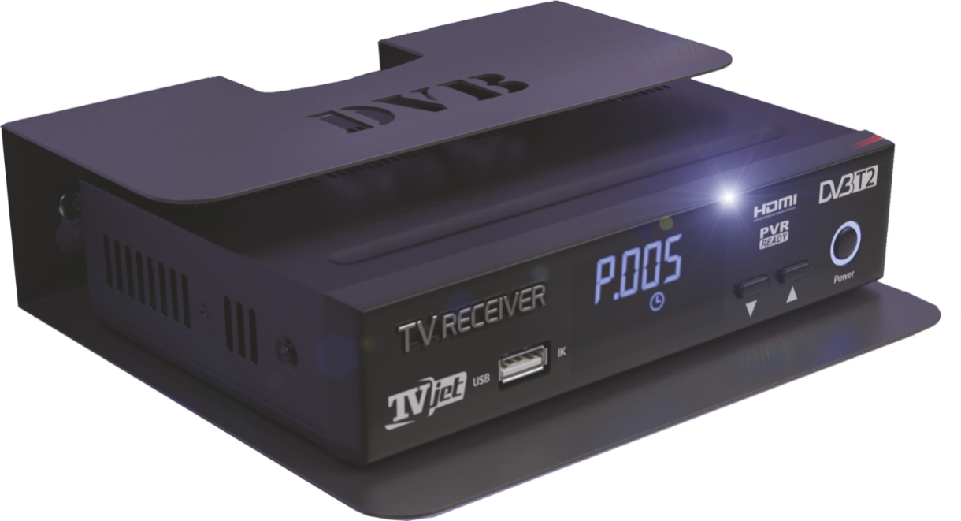

Slide 6
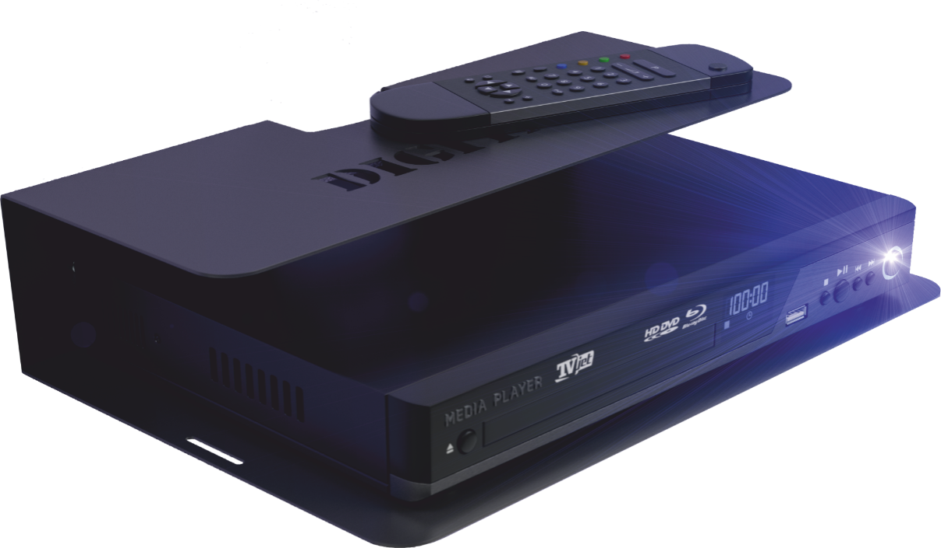

Slide 7
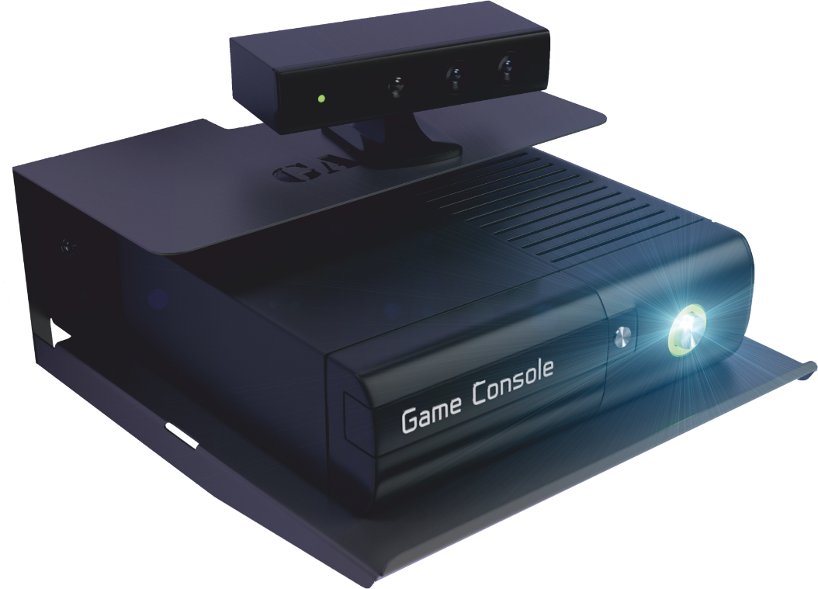

Slide 8
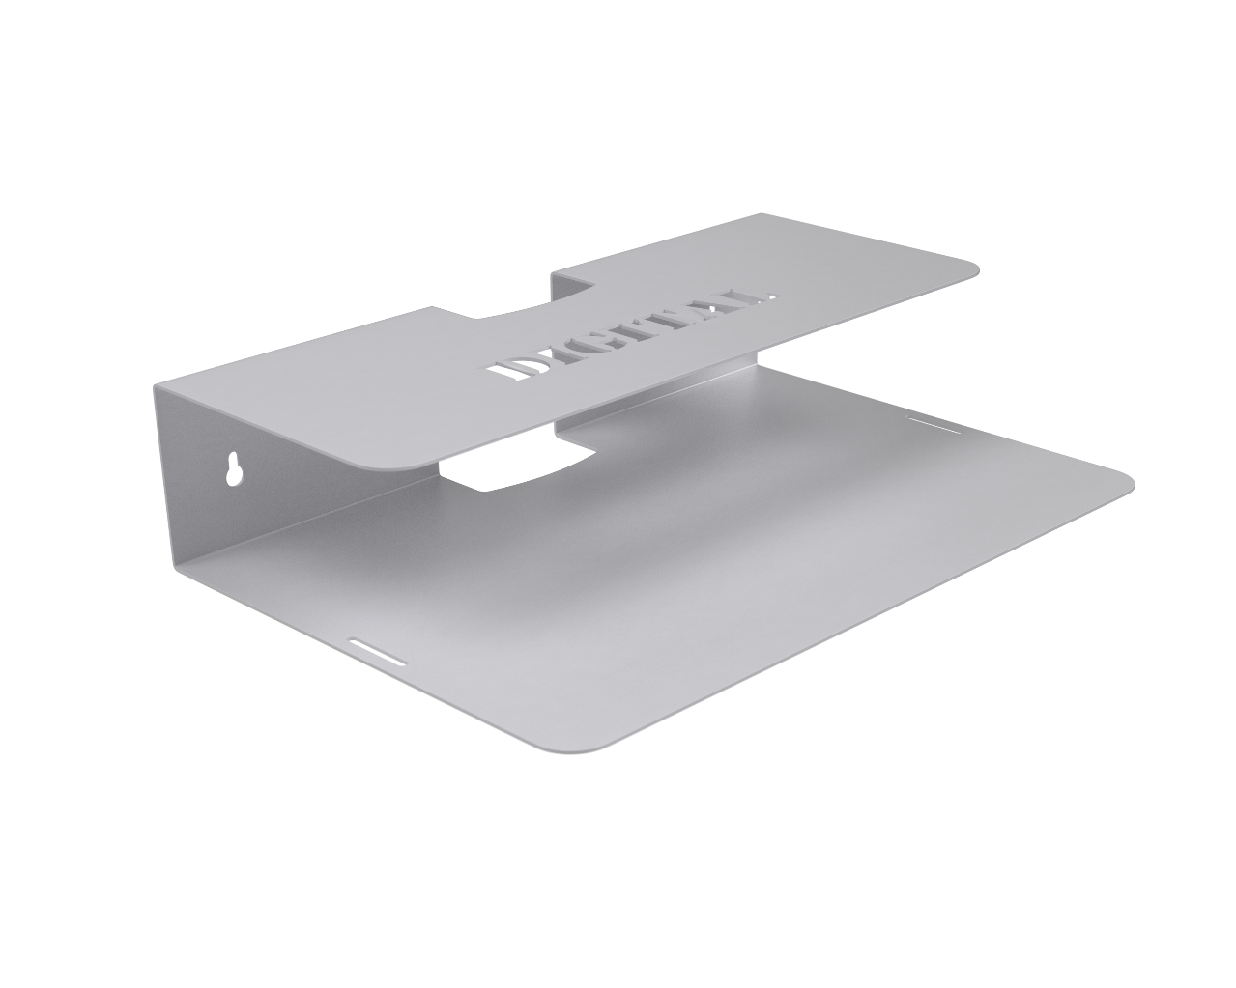
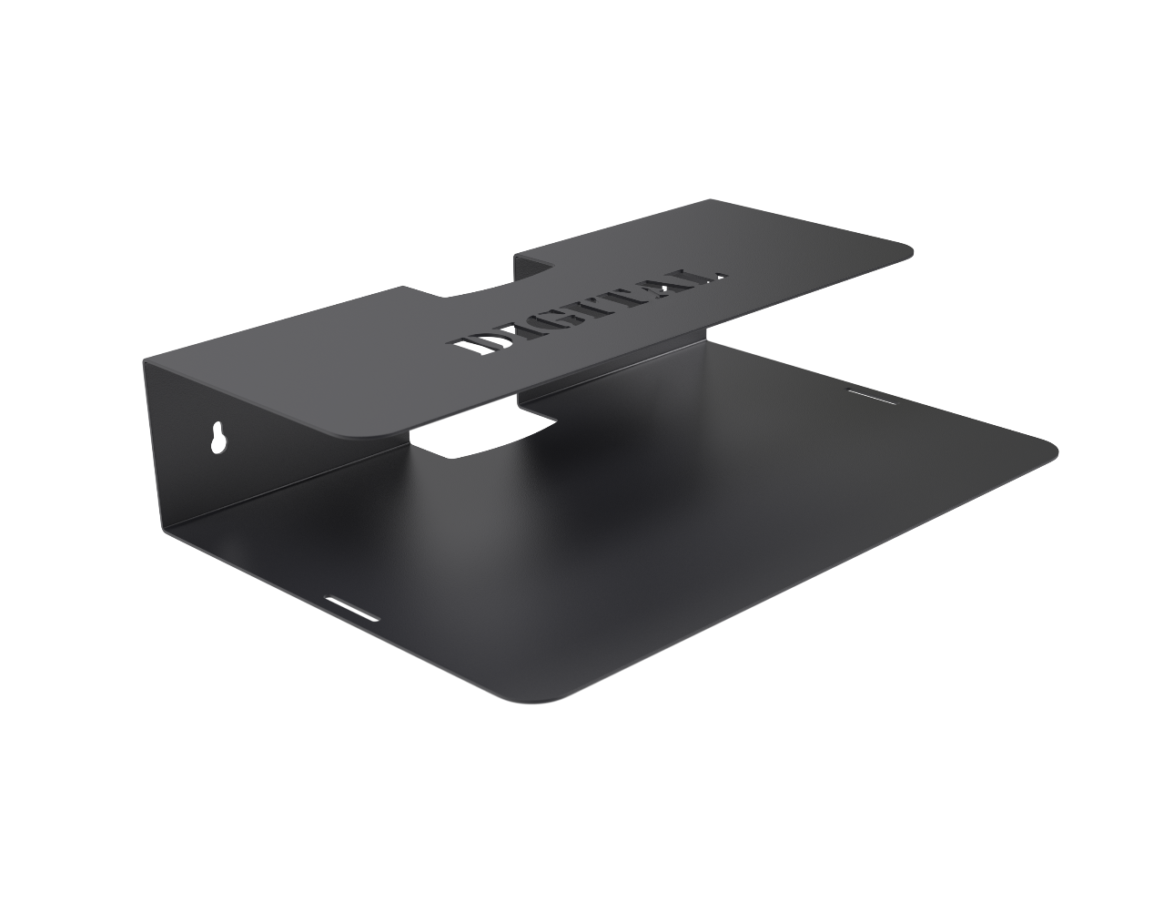
CHOOSE YOUR COLOR

Slide 9
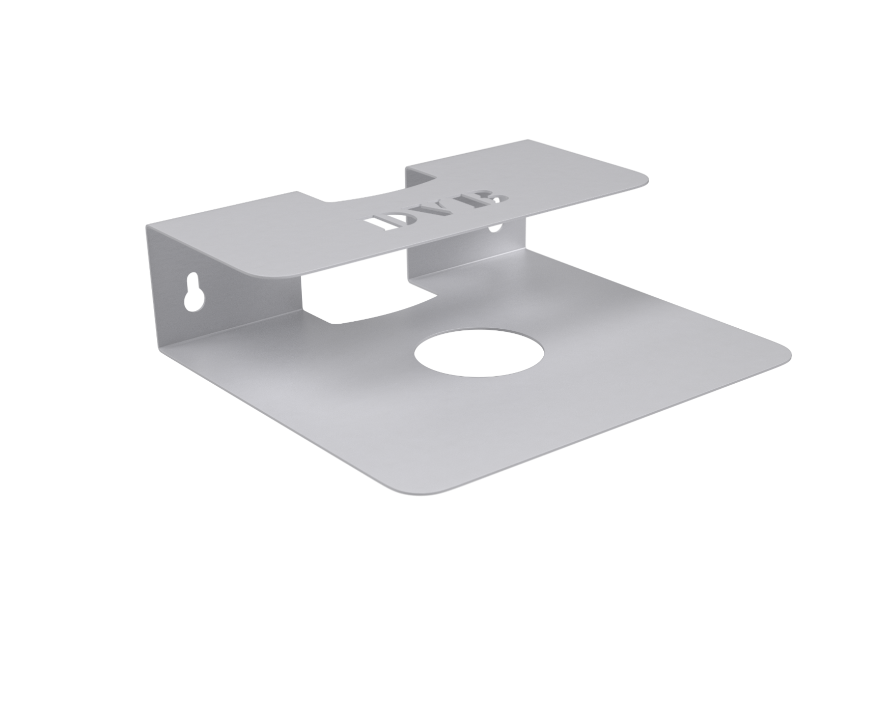
SHELVES WITH CORPORATE DESIGN
Major customers and OEM clients may customize:
Full color liner on your packing
Product color
Sign on the top shelf surface

Slide 10
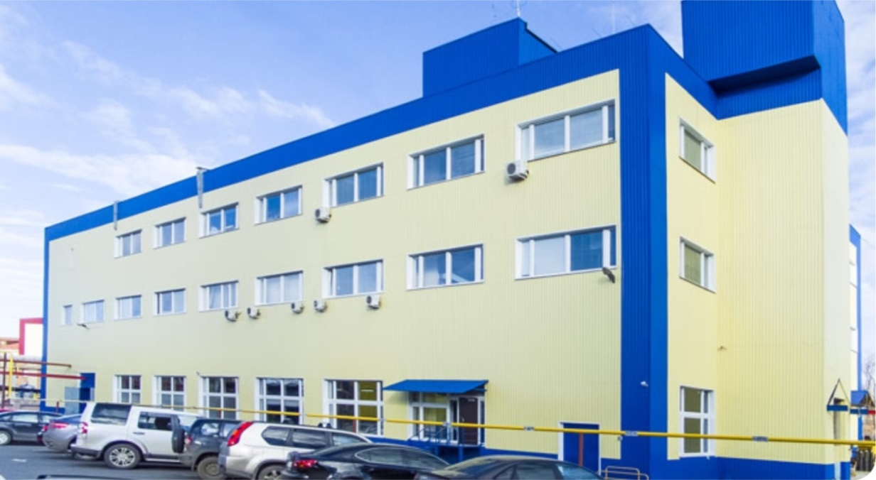
REMO Ltd.
P.O. Box 1334, Saratov, 410054, Russian Federation
Tel.: +7 (8452) 49-52-35 - Sales Department
e-mail: online@remo-zavod.ru
http://www.remo-zavod.ru
TRADING HOUSE REMO
Tel.: +7(8452)76-38-60 e-mail: remoexpress@bk.ru
INTERNET SHOP REMO
Tel.: +7(8452)46-96-57
E-mail: zakaz@remo-zavod.ru
SARATOV

