Slide 1
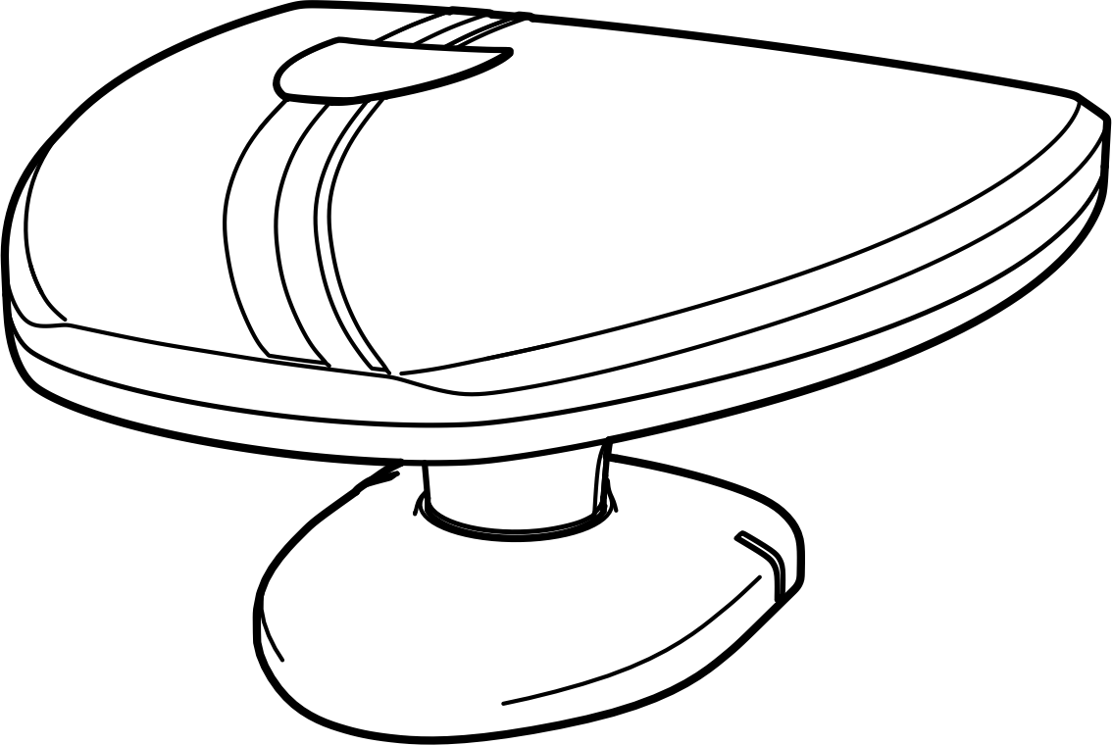

Slide 2
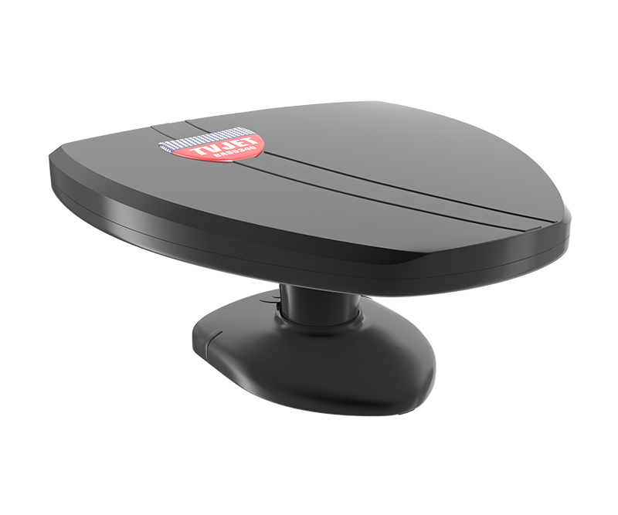
With its new amplifier IC chip,
indoor directional TV antenna
«remo BAS-5340 TVJET»
should be your great assistant in on-air free digital TV reception

Slide 3
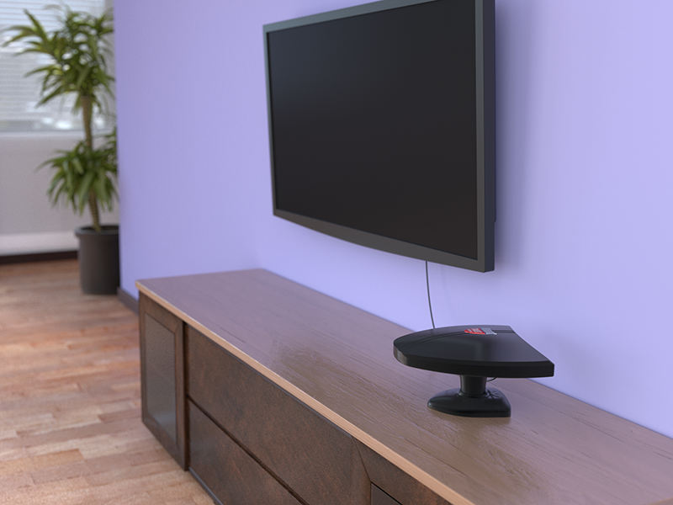
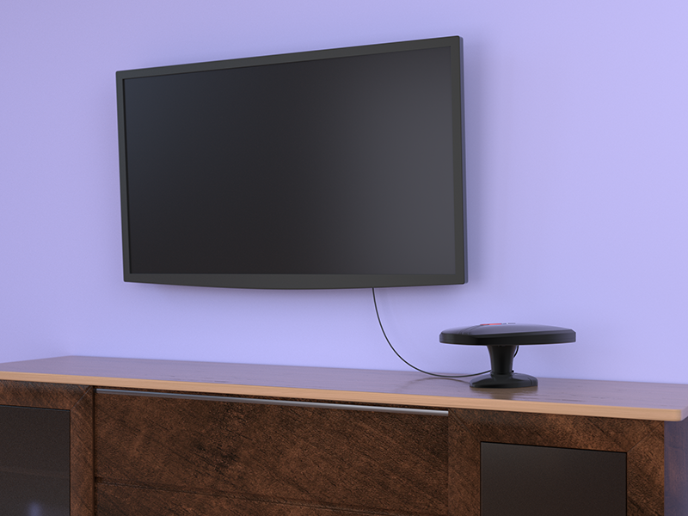
They look great pair in combination with black-coloured equipment

Slide 4
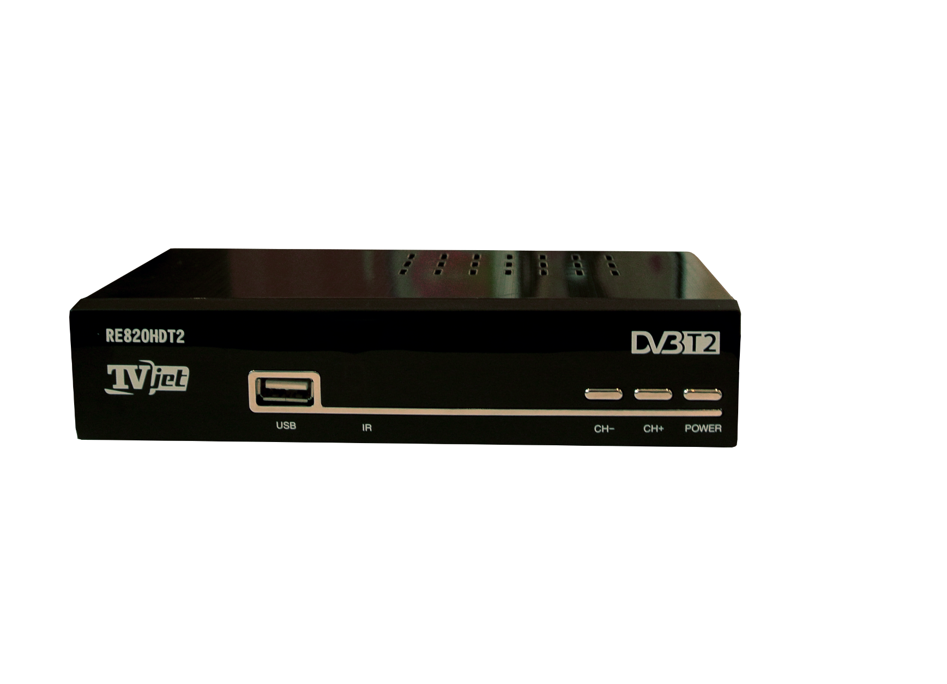
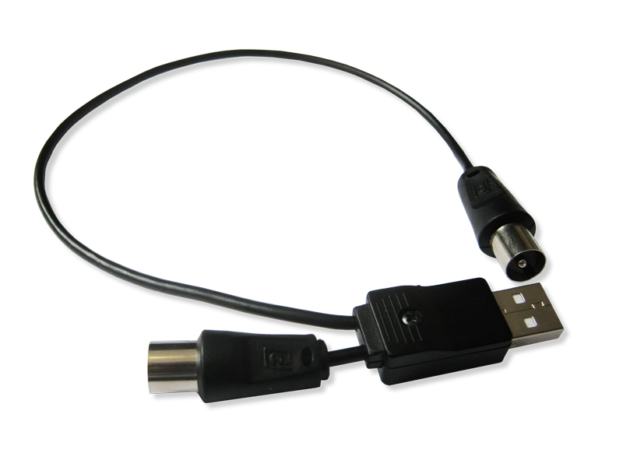
Two ways of power supply
USB
Digital Tuner
5 V

Slide 5
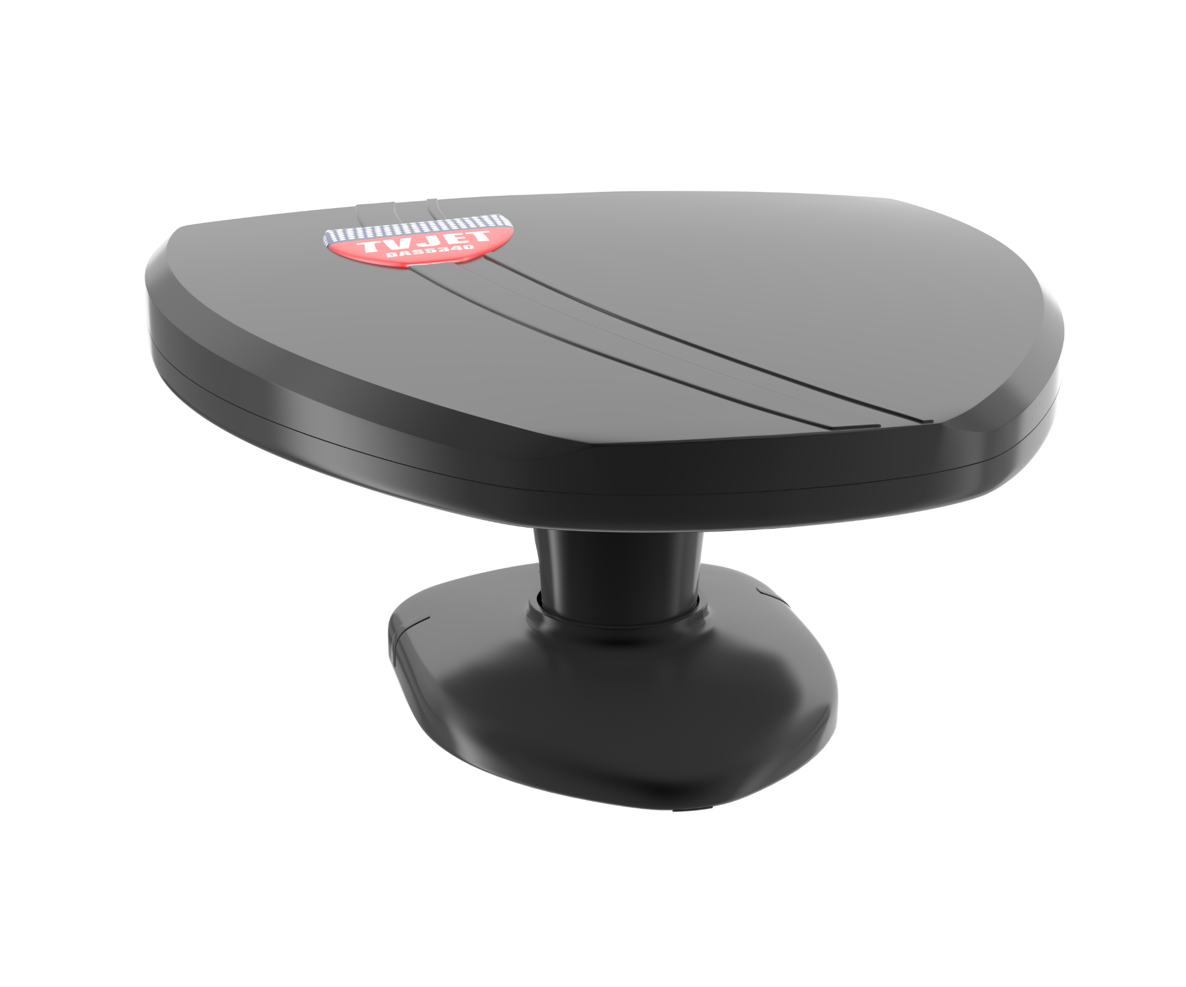
Specifications:
Antenna Type…………………..UHF
Gain, max., dBi:
Bas5340-5V..........................45
BAS5340-USB.......................45
Cable length, m.....................1.8
Weight, not more than, kg ……0.7
Packing dimensions, mm: 250х235х80

Slide 6
Directional indoor antenna is perfectly compatible with digital TV receiverTVJET RE820HDT2

Slide 7
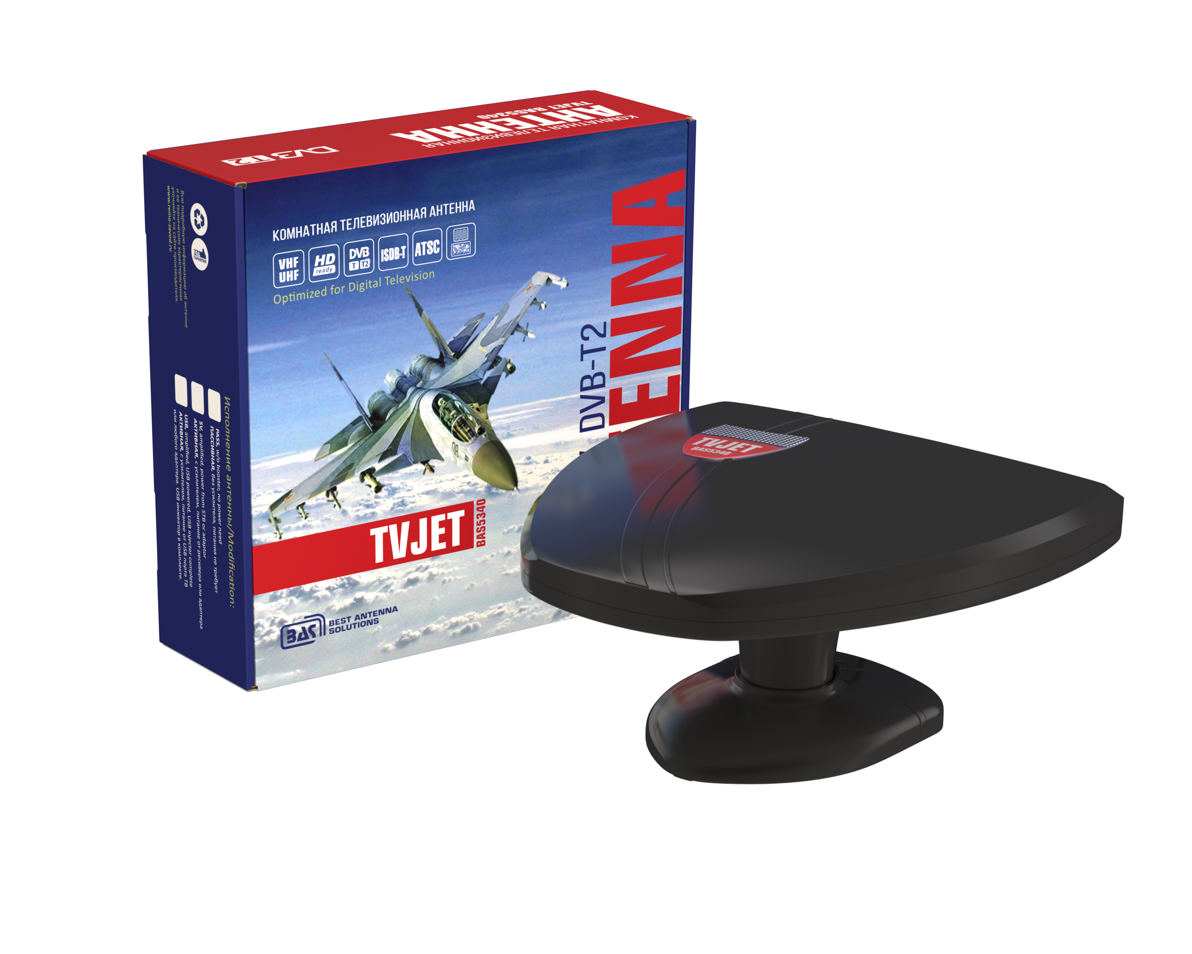
Excellent price and quality combination
High marginality for your partners
Multicoloured packing
Traditional configuration with new amplifier

Slide 8
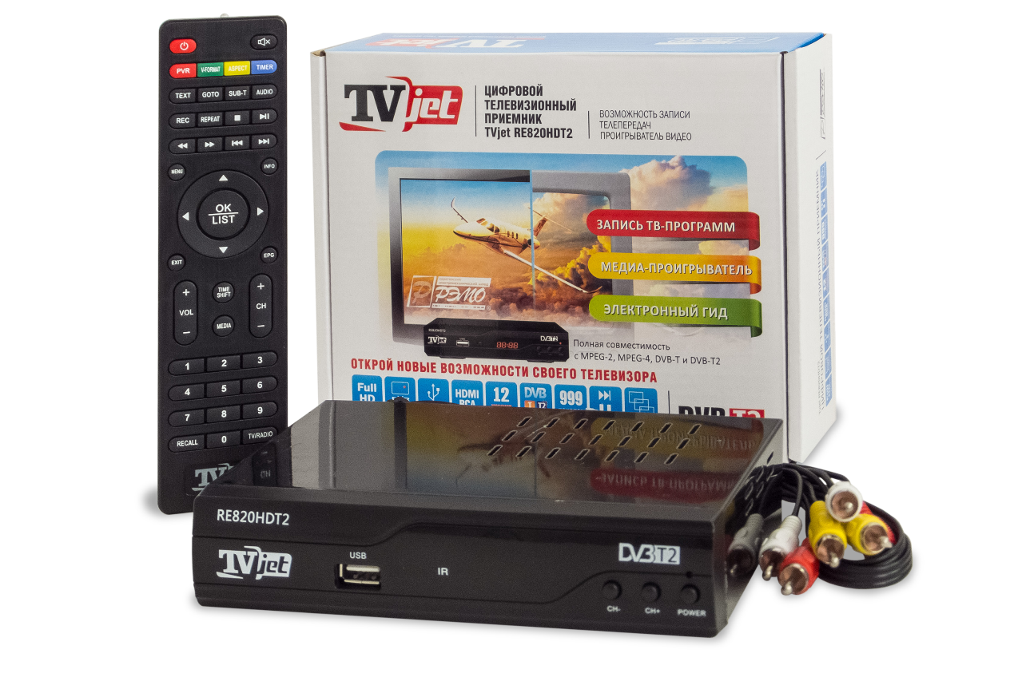
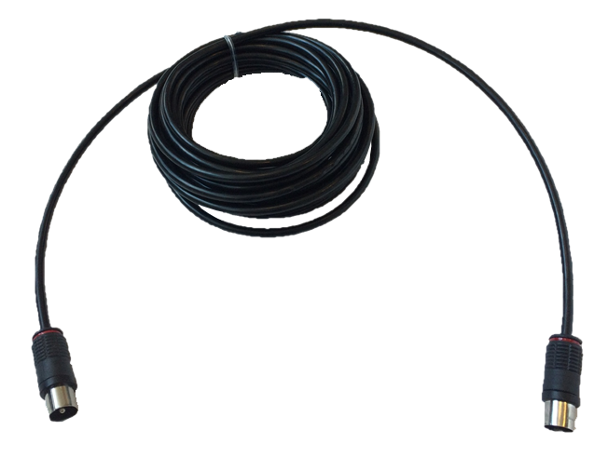
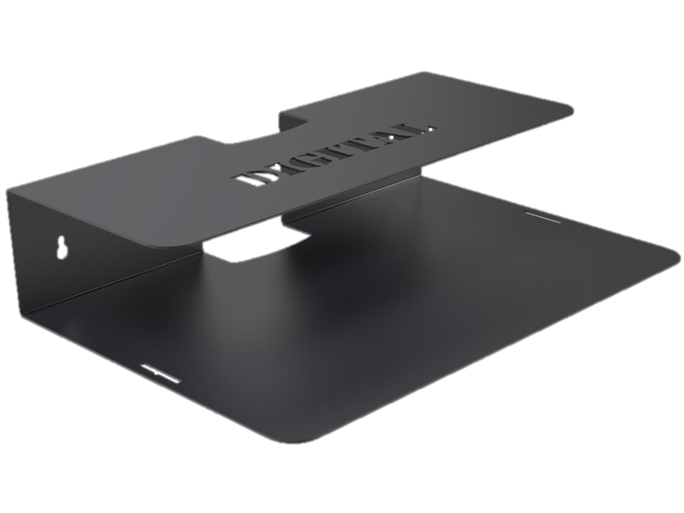
Need accessories?
DIGITAL TV TUNER TVJET
ANTENNA EXTENSION УА-5
WALL SHELF – m

Slide 9
REMO LTD 50 Let Oktyabrya, 101, Saratov, 410033, Russia +7(8452) 49-32-35 online@remo-zavod.ru

